Slide 1

INNOVATIVE TECHNOLOGIES, SURAT
ISO 9001 : 2015 ,ISO 14001 : 2015 & ISO 45001: 2018 Authorized Integration Partner of M/s CSL SILICONES INC. CANADA
Contact information
Mobile: +91 99989 64812
Office: +91 76980 61078 / 99989 64813
Email: techquery2000@gmail.com

Slide 2
INNOVATIVE TECHNOLOGIES, SURAT, INDIA
About us:
Innovative Technologies come up with fresh ideas every moment. We implement these ideas to innovate new landmarks in the path of our success. We have a firm belief in Devotion, Dedication, Discipline, Hard work and Teamwork without which we think success can't be achieved.
Innovative Technologies has drawn up ambitious plans for the future aimed at diversifying its operations. To sum up, Innovative Technologies is just a 25 years young firm. It has done pretty well in a short time and in the near future, we can give new dimensions and definitions to the electric world.
This represents our goal to bring about positive change & Strive to achieve something better. Every employee of the Innovative Group is resolved to carry on our mission to realize a better tomorrow through continuous innovation.

Slide 3
INNOVATIVE TECHNOLOGIES, SURAT, INDIA
We innovative Technologies has started our carrier from 1997 with Specialty Industrial Maintenance Products & providing customized solution to the Corporate , Government , Semi Government etc… Customer
We have been associate with CSL Silicones Inc. , Canada since 2009 as assistant for sales & application of Si Coat 570 RTV HVIC to there Indian partner W S Industries .
Further we have been directly associates with CSL Silicones Inc. & we focused on only CSL business & started direct business from 2015 exclusively focused on CSL product & our entire turn over is from CSL business only.

Slide 4
INNOVATIVE TECHNOLOGIES, SURAT, INDIA
We Innovative Technologies are associated with Essar Group now Arcelor Mittal Group on ARC Basis , Adani Group on ARC Basis, PGCIL, Torrent Group, India Cement, Shree Cement, Ultratech Cement , Tata Group on OLA basis & working continuously since 2010.
We are having continuous business of 05 Tons With Arcelor Mittal, 05 Tons with Adani Group, 05 tons With Tata Group& 05 tons with Cement Industries on Yearly basis.
Our biggest single largest order was we had executed amounting Rs.4.5 Crore from PGCIL, WR satisfactorily.

Slide 5
Our Organization structure:-
WE ARE HAVING FOLLOWING TEAM :
PROPERITOR – 01 PERSON
ACCOUNTANT – 01 PERSON
SALES ENGINNER – 01 PERSON
SITE SUPERVISOR – 02 PERSON
EXPERT APPLICATOR – 05 PERSON
HELPER – 10 PERSON

Slide 6
INNOVATIVE TECHNOLOGIES, SURAT, INDIA
Historical Data
Year | Mtrl Purchased in Kgs | Value in USD
2017 | 14514 | 221929
2018 | 32408.8 | 497758
2019 | 34559 | 511769
2020 | 12662.40 | 215260.80
2021 | 15841.4 | 237621
2022 | 16242.3 | 243634.50
2023 | 7090.4 | 106356
 | 133318.3 | 2034328.30

Slide 7
Quantity Of Supply

Slide 8
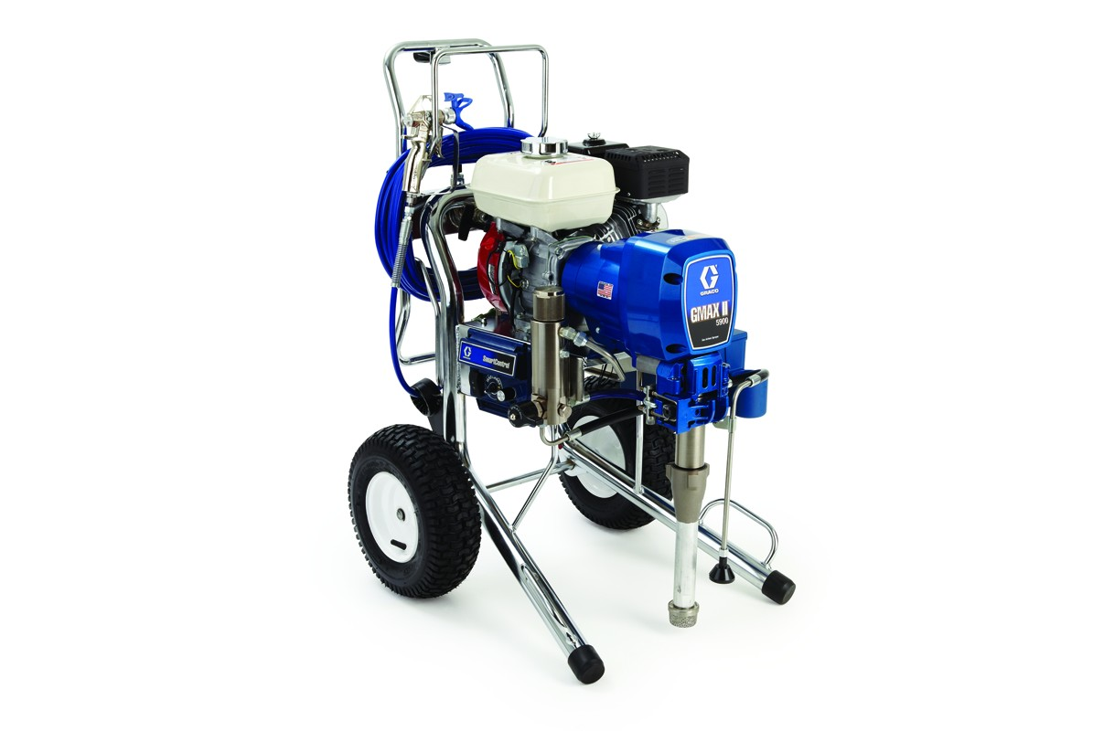
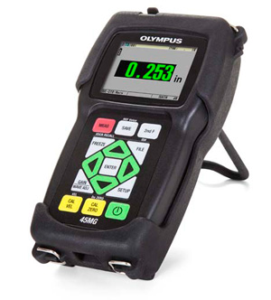
Our Resources for Execution :-
INNOVATIVE TECHNOLOGIES, SURAT, INDIA
INNOVATIVE TECHNOLOGIES, SURAT, INDIA
Our Resources for Execution
GRACO , USA MAKE PUMP FOR APPLICATION.
MARK IV ELECTRIC PUMP – 05 NOS.
3900 HD PETROL PUMP – 01 NOS.
WET FILM THICKNESS GAUGES – 02 Nos.
DRY FILM THICKENSS MEASURMENT OLYMPUS MAKE DL 45 MG – 01 NO.
POSITECTOR DeFelsko – 01 Nos.
10KV MEGGER
SCAFFOLDING & LADDERS
Material Preservative Room 200 Sq.Mtr

Slide 9
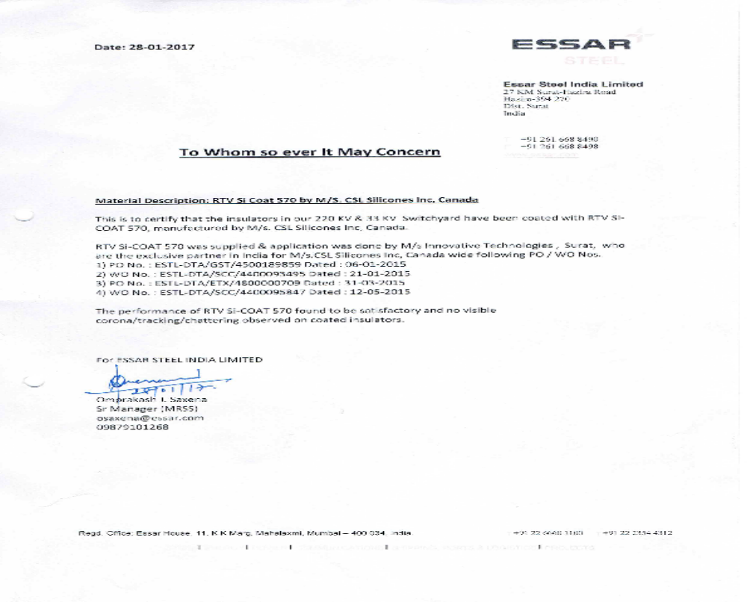
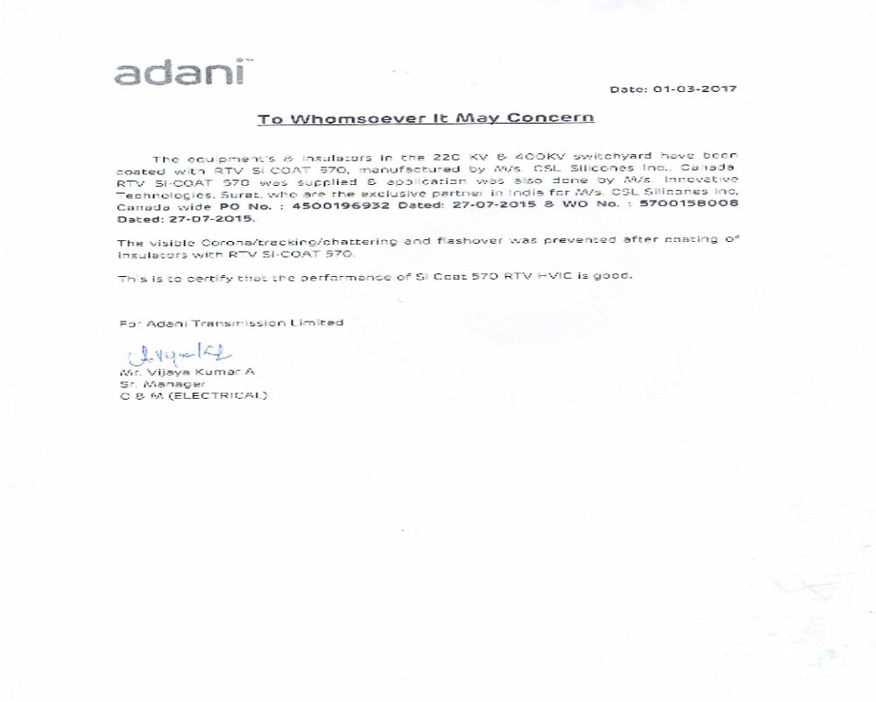
Performance Certificate

Slide 10
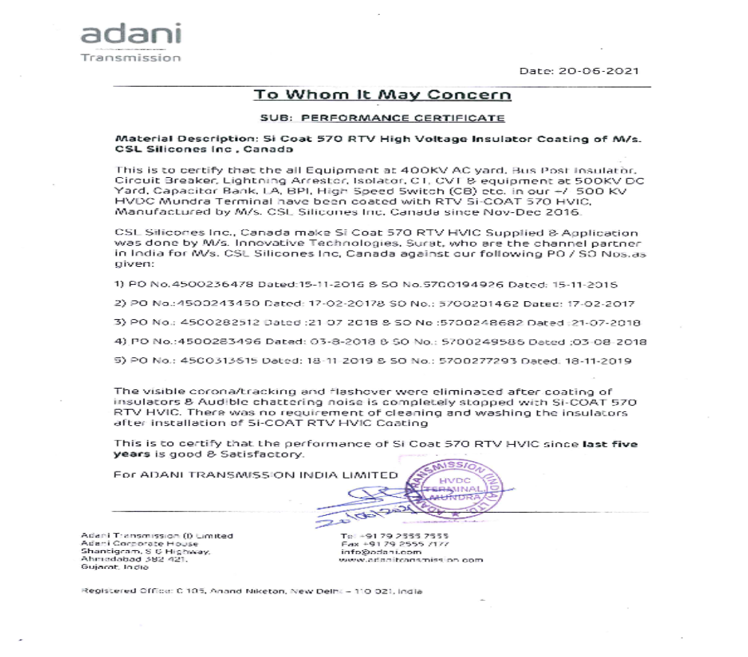
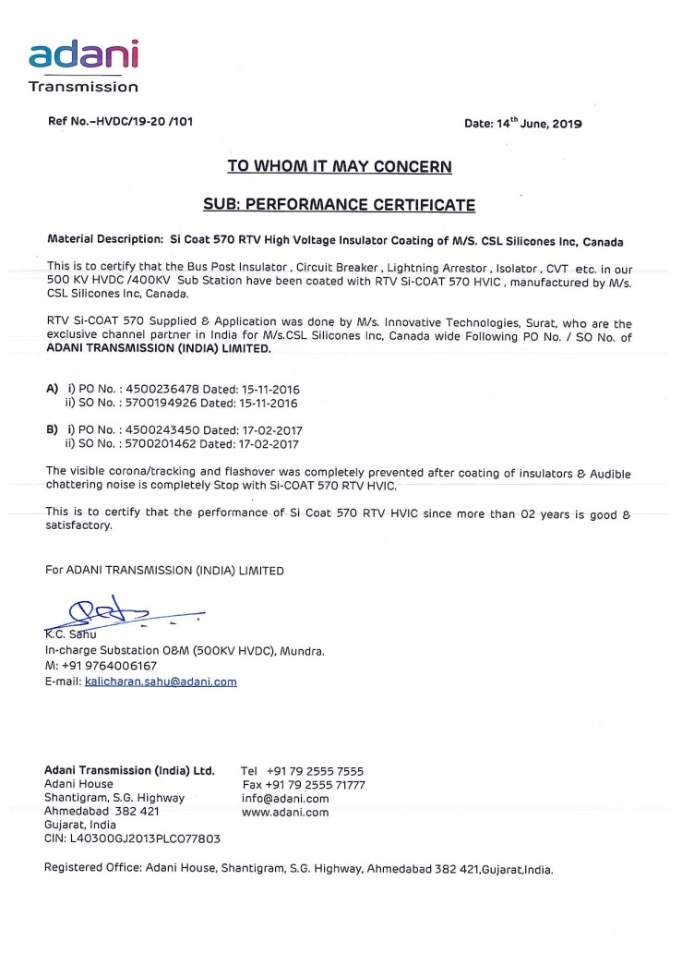
Performance Certificate

Slide 11
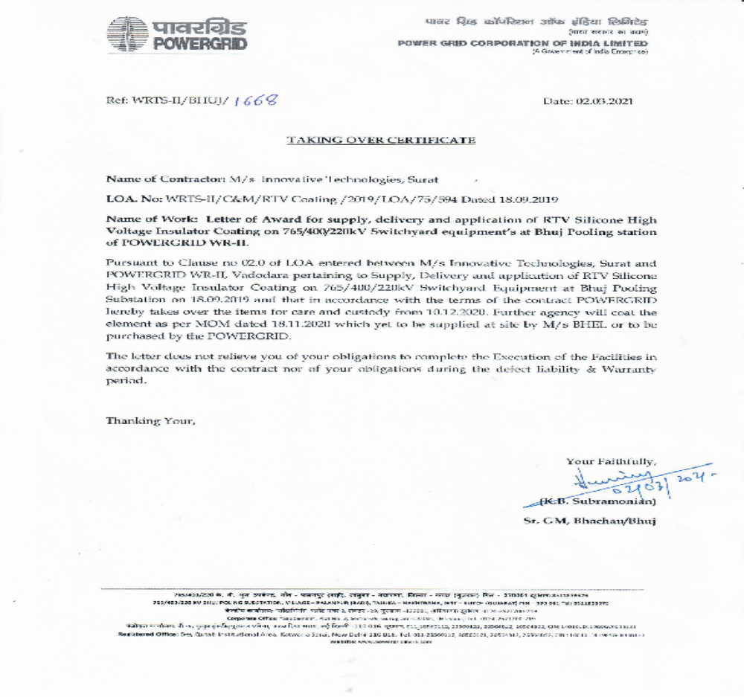
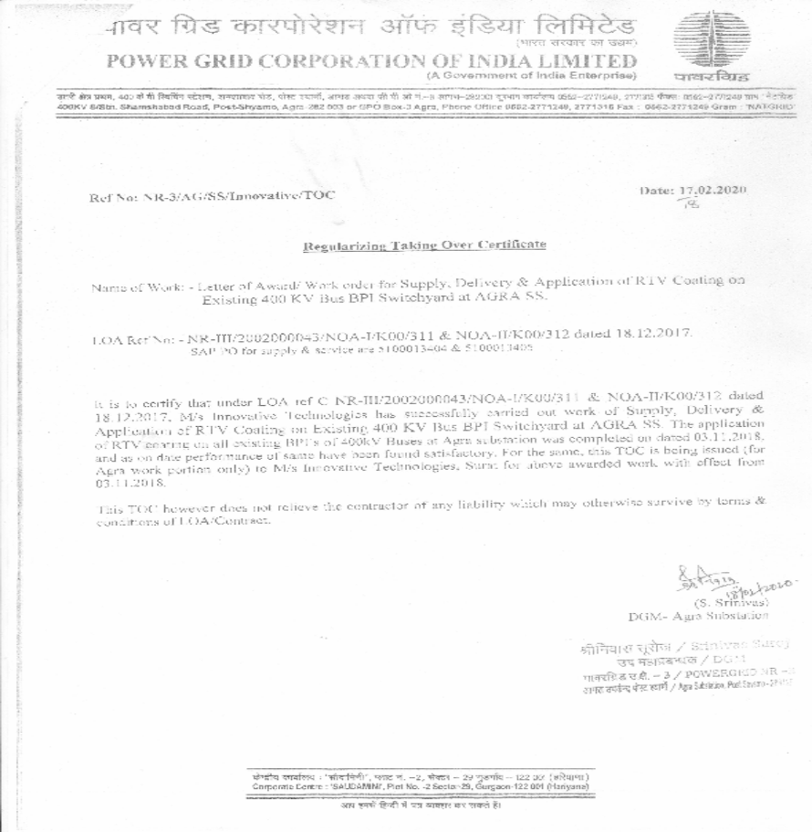
Performance Certificate

Slide 12
Order in Pipeline
1 | Tata Renewable Energy P. Ltd | INDIA | OLA No.9200018400 | Innovative | 570 | 7000 | KG | TENDER | 1.00 | Q1 & Q2
2 | Adani | INDIA | ARC | Innovative | 570 | 3000 | KG | ARC | 1.00 | Q1-Q2 & Q3
3 | AMNS | INDIA | ARC | Innovative | 570 | 2000 | KG | ARC | 1.00 | Q1-Q2 & Q3

Slide 13
Our Yearly Confirmed order Since Last 05 Years
Essar Steel India Limite – 03 Tons
Adani Transmission Ltd. – 03 Tons

Slide 14
Offer We have Submitted:-
1 | Hitachi Energy Limited | Enquiry thru Mail | 570 | 600 | Kg | 220 KV SS | Q3 | Under Approval from HO
2 | GETCO Dahez | Enquiry thru Mail | 570 | 1000 | KG | 220 KV SS | Q4 | Under Approval from HO
3 | JSW Steel Ballary | Enquiry Thru Mail | 570 | 500 | Kg | Trench Make Reactor | Q2 | Under Approval from HO
4 | KPTL KPS 2 & 3 Project | Enquiry thru Mail | 570 | 6290 | Kg | 765-220 KV SS | Q4 | Under Approval
5 | Sanghi Cement Kutchh | Thru Mail | 570 | 3500 | Kg | 220 KV SS | Q3 | Under Approval
6 | Siemens AMNS GIS Project | Thru Mail | 570 | 4940 | Kg | 400 KV GIS SS | Q4 | Tender Stage
 | Total |  |  | 16830 | Kg

Slide 15
Thank You
Innovative Technologies

